Slide 1




PROJECT REPORT
LEARNING MANAGEMENT SYSTEM
AT SD NEGERI 2 SARANJANA
Satria Yudha Purnomo | XII TJKT 3 | 28

Slide 2


OUTLINE
Chapter 1
Chapter 2
Chapter 3
      Background
      Purpose
      Tools and Materials
      Working Process
      Work Result
      Production Cost & Price
      Marketing Strategy
      Conclusion
      Suggestions

Slide 3




Page 3
Purpose
Background
Learning Management System is one of the features on the independent teaching platform which is used for learning programs. According to experts :
      LMS is software that is useful for online activities (Ellis, 2009).
      LMS is software for creating web-based online lecture materials (Riyadi, 2010).
      it can be concluded that LMS is a digital program for managing learning to make it more effective and efficient. LMS generally used for preparing material, managing the learning process, and assessing work results.
      Realizing that technology is developing rapidly, SD Negeri 2 Saranjana is taking part in this development so as not to be left behind in the use of technology for learning.
  Increasing access and quality of students’ opportunities and flexibility in learning.
2. Making it easier for teachers to deliver learning material, give assignments, and assess.
3. Providing and simplifying learning systems in formal education institutions.
4. Facilitating self-paced learning by allowing students to access materials anytime and anywhere
Satria Yudha Purnomo | XII TJKT 3 | 28

Slide 4




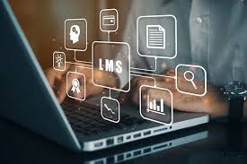

Halaman 5
CHAPTER 2
Alat
Langkah Kerja
      Komputer/Laptop
Bahan
      Tempat Hosting dan Domain
      Cloudflare Security
      Internet dan Listrik

Slide 5

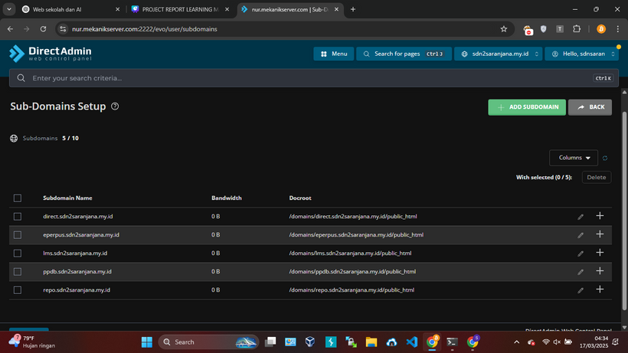
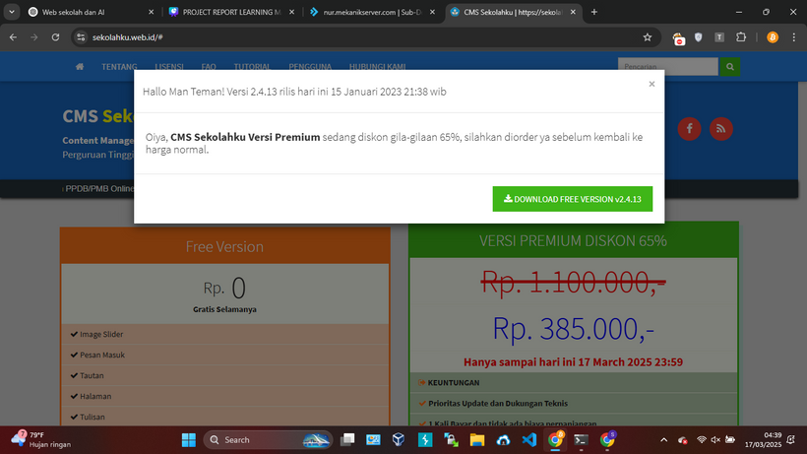
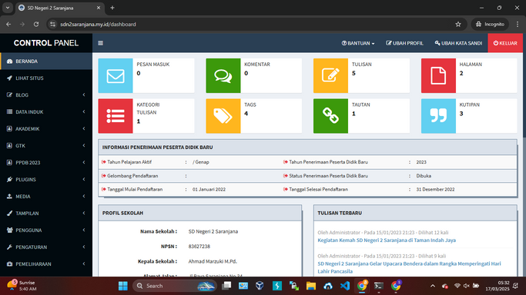
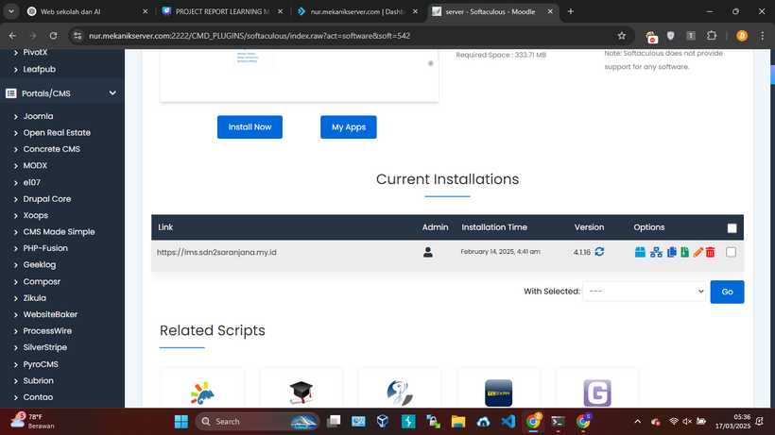
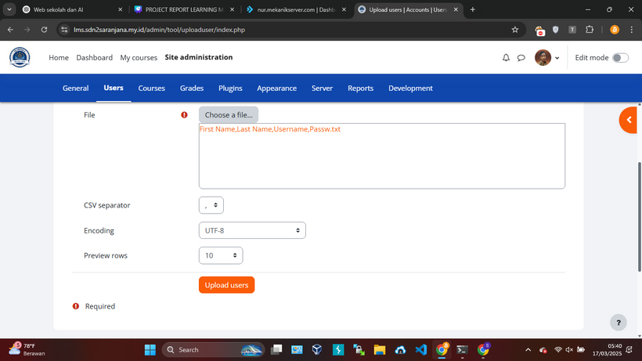
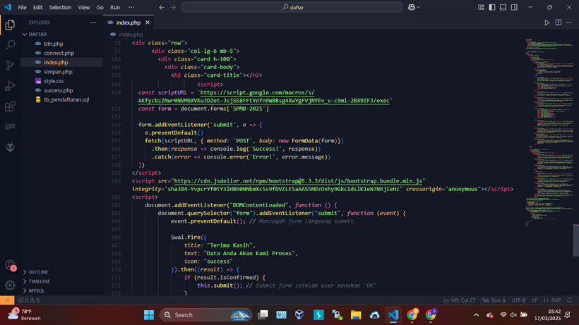

Halaman 6
Langkah Kerja
Membuat Sub-Domain yang diperlukan
Downlaod CMS Sekolahku dan di
upload ke tempat hosting
Login sebagai Admin dan edit hal
yang menyangkut sekolah
Memasang Moodle via Softaculous
Upload file .csv yang berisi data siswa
dan guru
Membuat laman ppdb dengan php
dan javascript
selengkapnya:
https://bit.ly/4iVB48z

Slide 6
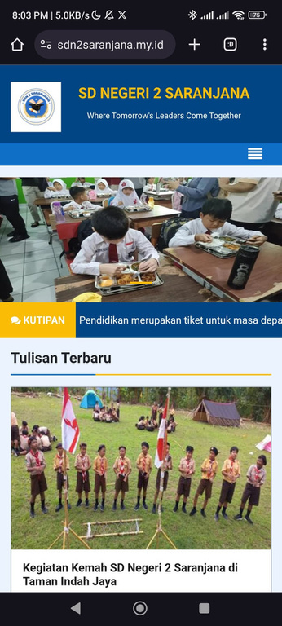
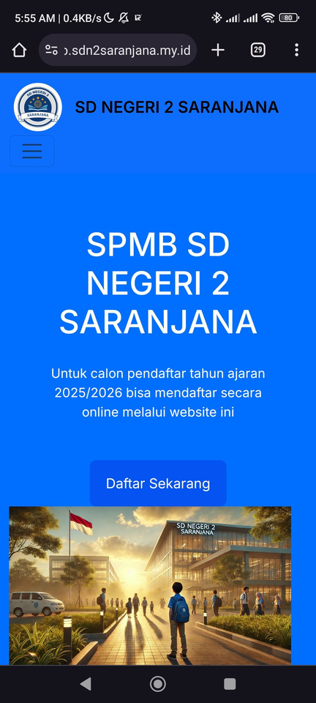
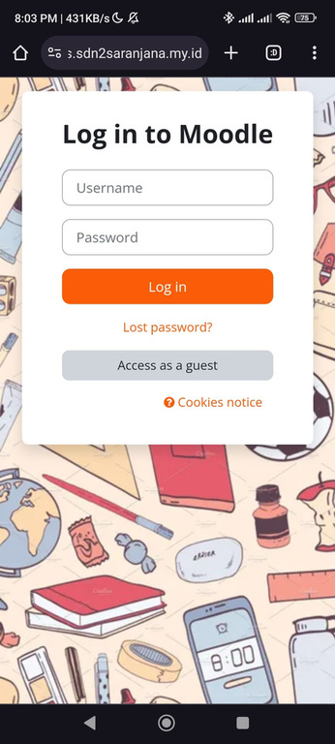


Work Results
Halaman 10
Website
PPDB
LMS
https://www.sdn2saranjana.my.id
https://ppdb.sdn2saranjana.my.id
https://lms.sdn2saranjana.my.id

Slide 7



Halaman 9
Production Cost
      Biaya Bahan Baku (BBB)
      Hosting + Domain = Rp25.000,00
      Cloudflare Security
      Biaya Tenaga Kerja Langsung (BTKL) = Rp300.000,00
      Biaya Overhead Pabrik (BOP)
      Listrik = Rp7.000,00
      Internet = Rp10.000,00
      Biaya Penyusutan Alat = Rp6.000,00 +
      Total BOP = Rp23.000,00 +
      Total Biaya Produksi (HPP) = Rp463.000,00
= Rp55.000,00
Price
      Harga Pokok+ Laba 25%
      Rp403.000,00 + (25% x Rp403.000,00)
      Rp463.000,00 + Rp100.750,00
      > Rp503.750,00

Slide 8

Halaman 10
Marketing
Market Targeting
Our target clients are elementary schools (SD/MI or equivalent), junior high schools (SMP/MTs or equivalent), and senior high schools (SMA/SMK/MA or equivalent). One of our existing clients is SD N 2 Saranjana, and we aim to acquire five more school clients within this year.
Marketing Strategy
      Product: We provide an LMS with exciting features, one of which allows clients to open PPDB (New Student Admission). When applicants fill out the registration form, a proof of registration will be sent to their Gmail automatically.
      Price: We offer a special price for the first three clients who subscribe for one year. They will receive a 5% discount on their monthly payments, reducing the price from Rp 500,000.00 to Rp 475,000.00 per month.
      Place: Clients who wish to subscribe can contact us via WhatsApp at 081350196185 or visit our office at Jl. Pasuruhan Kidul No. 340, Pasuruhan Kidul, Kec. Jati, Kabupaten Kudus, Jawa Tengah 59349.
      Promotion: We promote this Learning Management System through school visits for direct socialization, creating advertisements on social media, and distributing pamphlets.

Slide 9

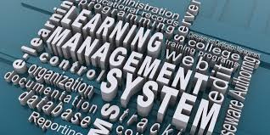


Halaman 11
Chapter 3
Conclusion
A Learning Management System (LMS) plays a crucial role for educators, allowing them to provide learning materials and assignments that can be accessed anytime and anywhere.
Closing
Suggestion
      The active participation of educators and students is essential for updating information, materials, and assignments.
      If any issues arise with the system, it is recommended to contact the system developer as soon as possible.
      We hope that educators will help socialize the use of this LMS to students to facilitate its operation during the learning process.

Slide 10

Thank you
Satria Yudha Purnomo | XII TJKT 3 | 28

